Slide 1
Java Project
Scamazon
Kyle Beckley
Kody Martens
Logan Hibbard
Alex Buhler

Slide 2
Introduction
An easy to use shopping app that allows users to buy and sell products
Desktop and mobile application
Top other shopping apps on the market

Slide 3
Components
Database to store items, users,
Networking to communicate between buyer and seller

Slide 4
Main Classes
Item class: Price, desc, rating, ISBN number
User profile: balance, item cart, personal info
GUI: swing
SQLMethods: methods for reading/writing/ accessing database
Search functions, ect methods

Slide 5
Kyle
Item Class: item info, print method
SQLMethods: read to and from database, search method for finding items

Slide 6
Kody
Implementation of Shopping Cart
Search History Implementation
Implementations of Item Search

Slide 7
Logan
User Class, logins, account creation, searching
Create User database entries
Linking backend to Interface
Implementation of Category Buttons

Slide 8
Alex
Set up user interface(GUI)
Created a usable page based on designs and expectations in the group meetings
Designed navigation between pages.
Connected actions to various buttons, next, previous

Slide 9
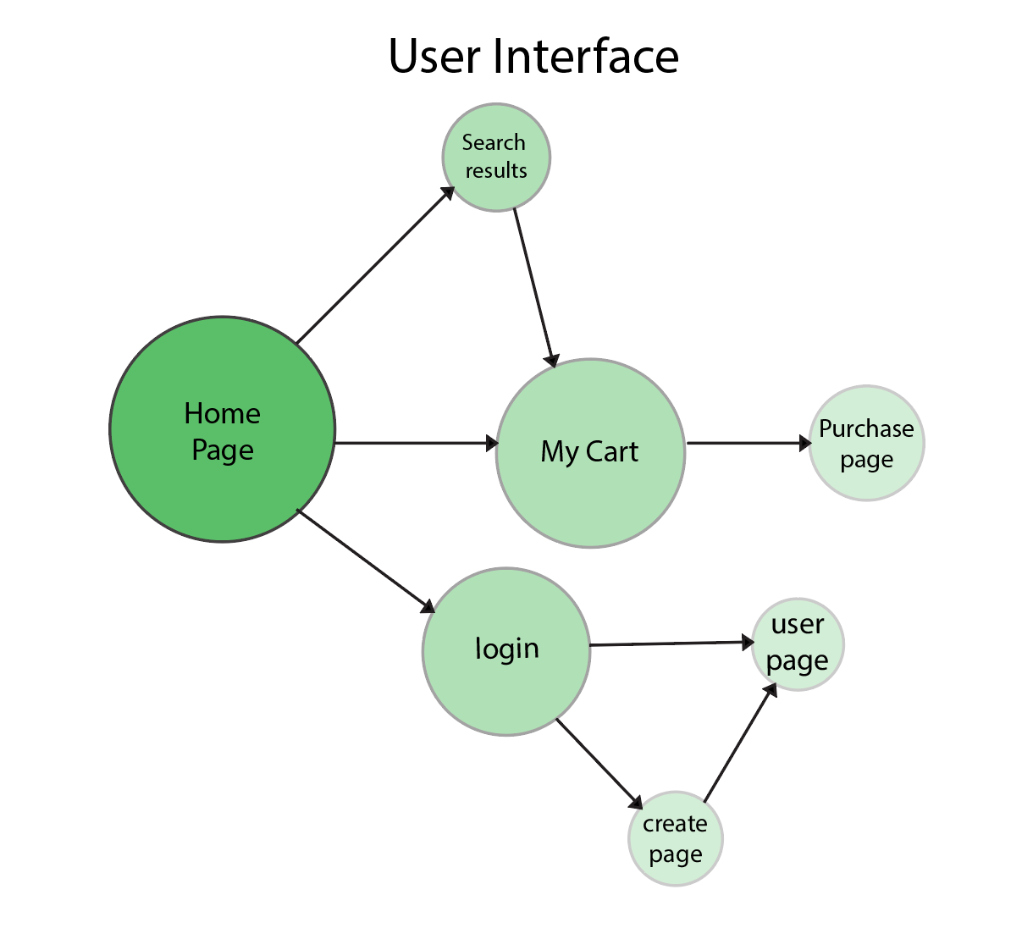

Slide 10
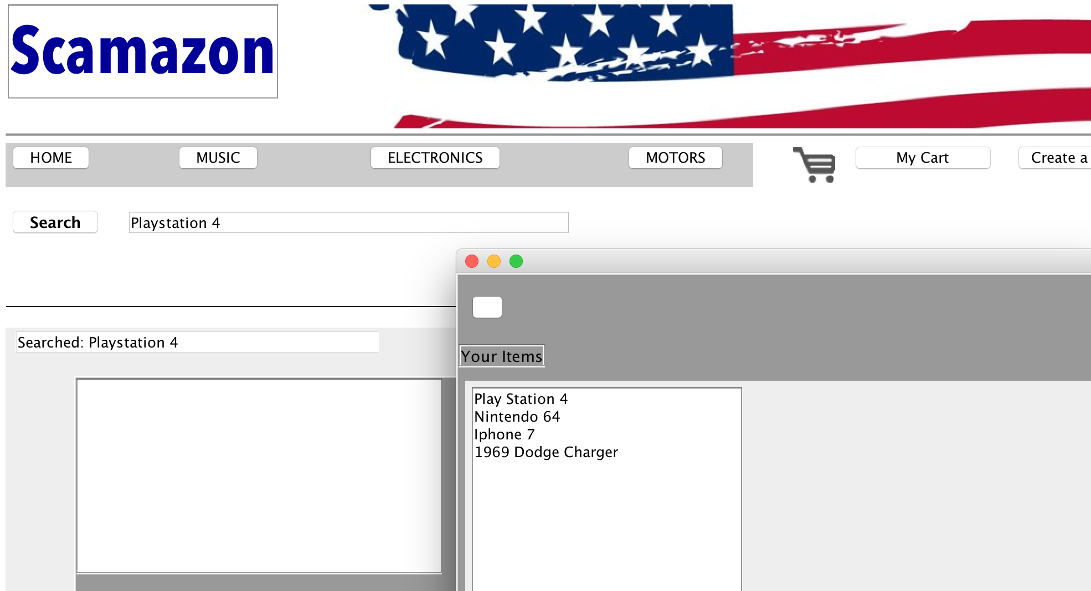

Slide 11
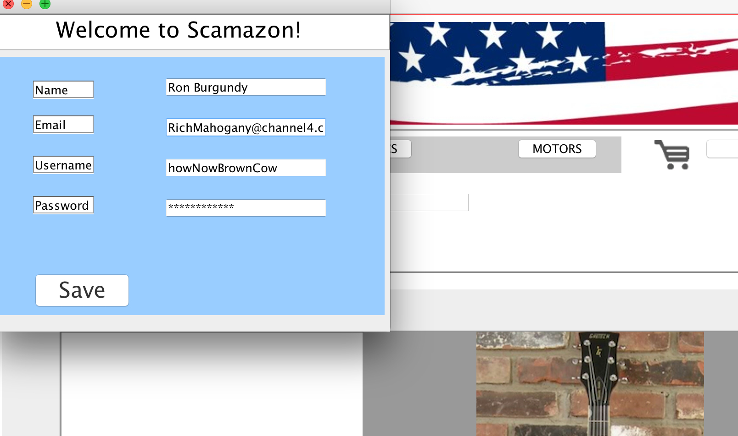

Slide 12
Functionability
Database: holding item and user class information
Item cart: user adds items to later “buy”
Item search: search for items by keywords or isbn if applicable
Categories: electronics, books, etc.

Slide 13
Stretch goals
Release within another month time
Full network functionality
Listing items to sell
Improved interface

